Slide 1
Lecture 8
Nick Rugai PhD

Slide 2
Arrays
Write a function that splits an array at a determined spot and moves the two parts.
Rewrite it using print statements.

Slide 3
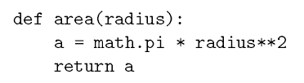

Return
Functions that do not return anything are called void.
Functions can have a return:

Slide 4
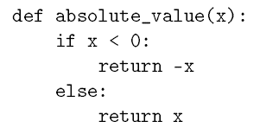
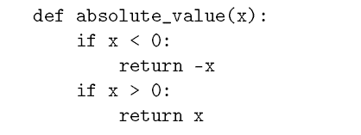
Return
Functions can have multiple return values.
Write the following functions and see what happens when the value if 0:

Slide 5

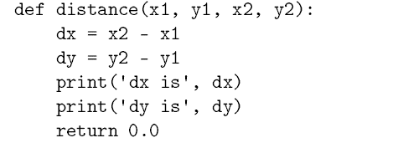
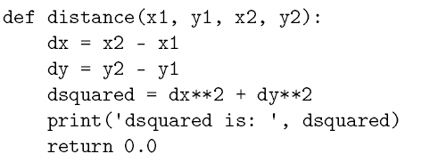
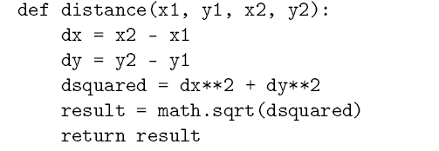
Incremental Development
Run your function often before it is complete and use print() to debug.
Write a function that calculates the distance given two coordinate points:

Slide 6

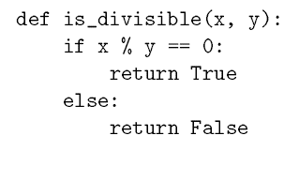
Return
Functions can return other functions:
A boolean function returns true or false:

Slide 7

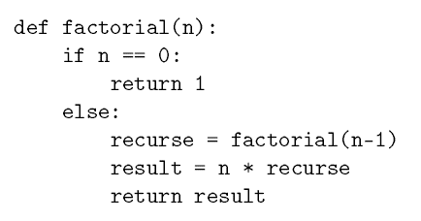
Return And Recursion
Write a function for factorial number:
Recursion is always a Leap-of-Faith!
What happens when the argument is a string or a negative integer?

Slide 8
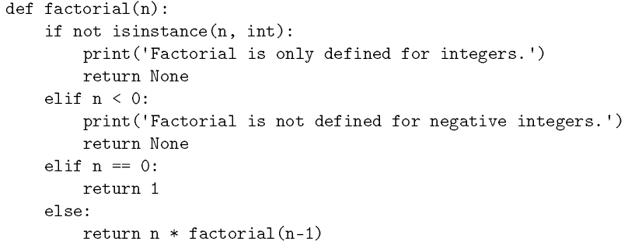
Return And Recursion
You must assume the user will enter anything!

